Slide 1

Dungeon Positioning System
CSC 490 Spring ‘19
Notes:
https://github.com/gnpurvin/CSC490DPS

Slide 2
Project Overview
Playing Tabletop Roleplaying Games usually requires access to a lot of separate resources and time to organize and combine elements of these resources into a cohesive game. It is also frustrating to sift through multiple different physical resources and create and manage dungeons on the fly. The Dungeon Positioning System (DPS) aims to remedy that.
Dungeon Positioning System (DPS for short) will be a way for people to play roleplaying games via the internet. DPS will also help manage all the boring and complicated bookkeeping that goes along with playing these types of games.
There will be different views for the DM and players, in order to streamline usability.
Notes:
Made features its own slide

Slide 3
Features
Map making tools
Dice roller
Character sheet manager
Premade enemies and NPCs
Session Manager
Game Log/Text Chat

Slide 4
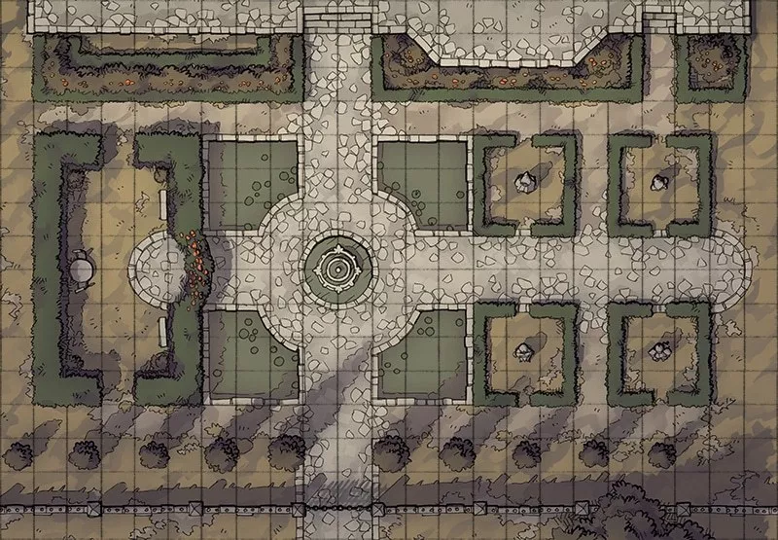
Maps
Movable tokens
Tied to a session
Custom Map Maker
Drag and drop environment objects
Drawable
Useful for specific needs
Random Map Generator
Different environments and settings
Buildable
Useful to start up

Slide 5
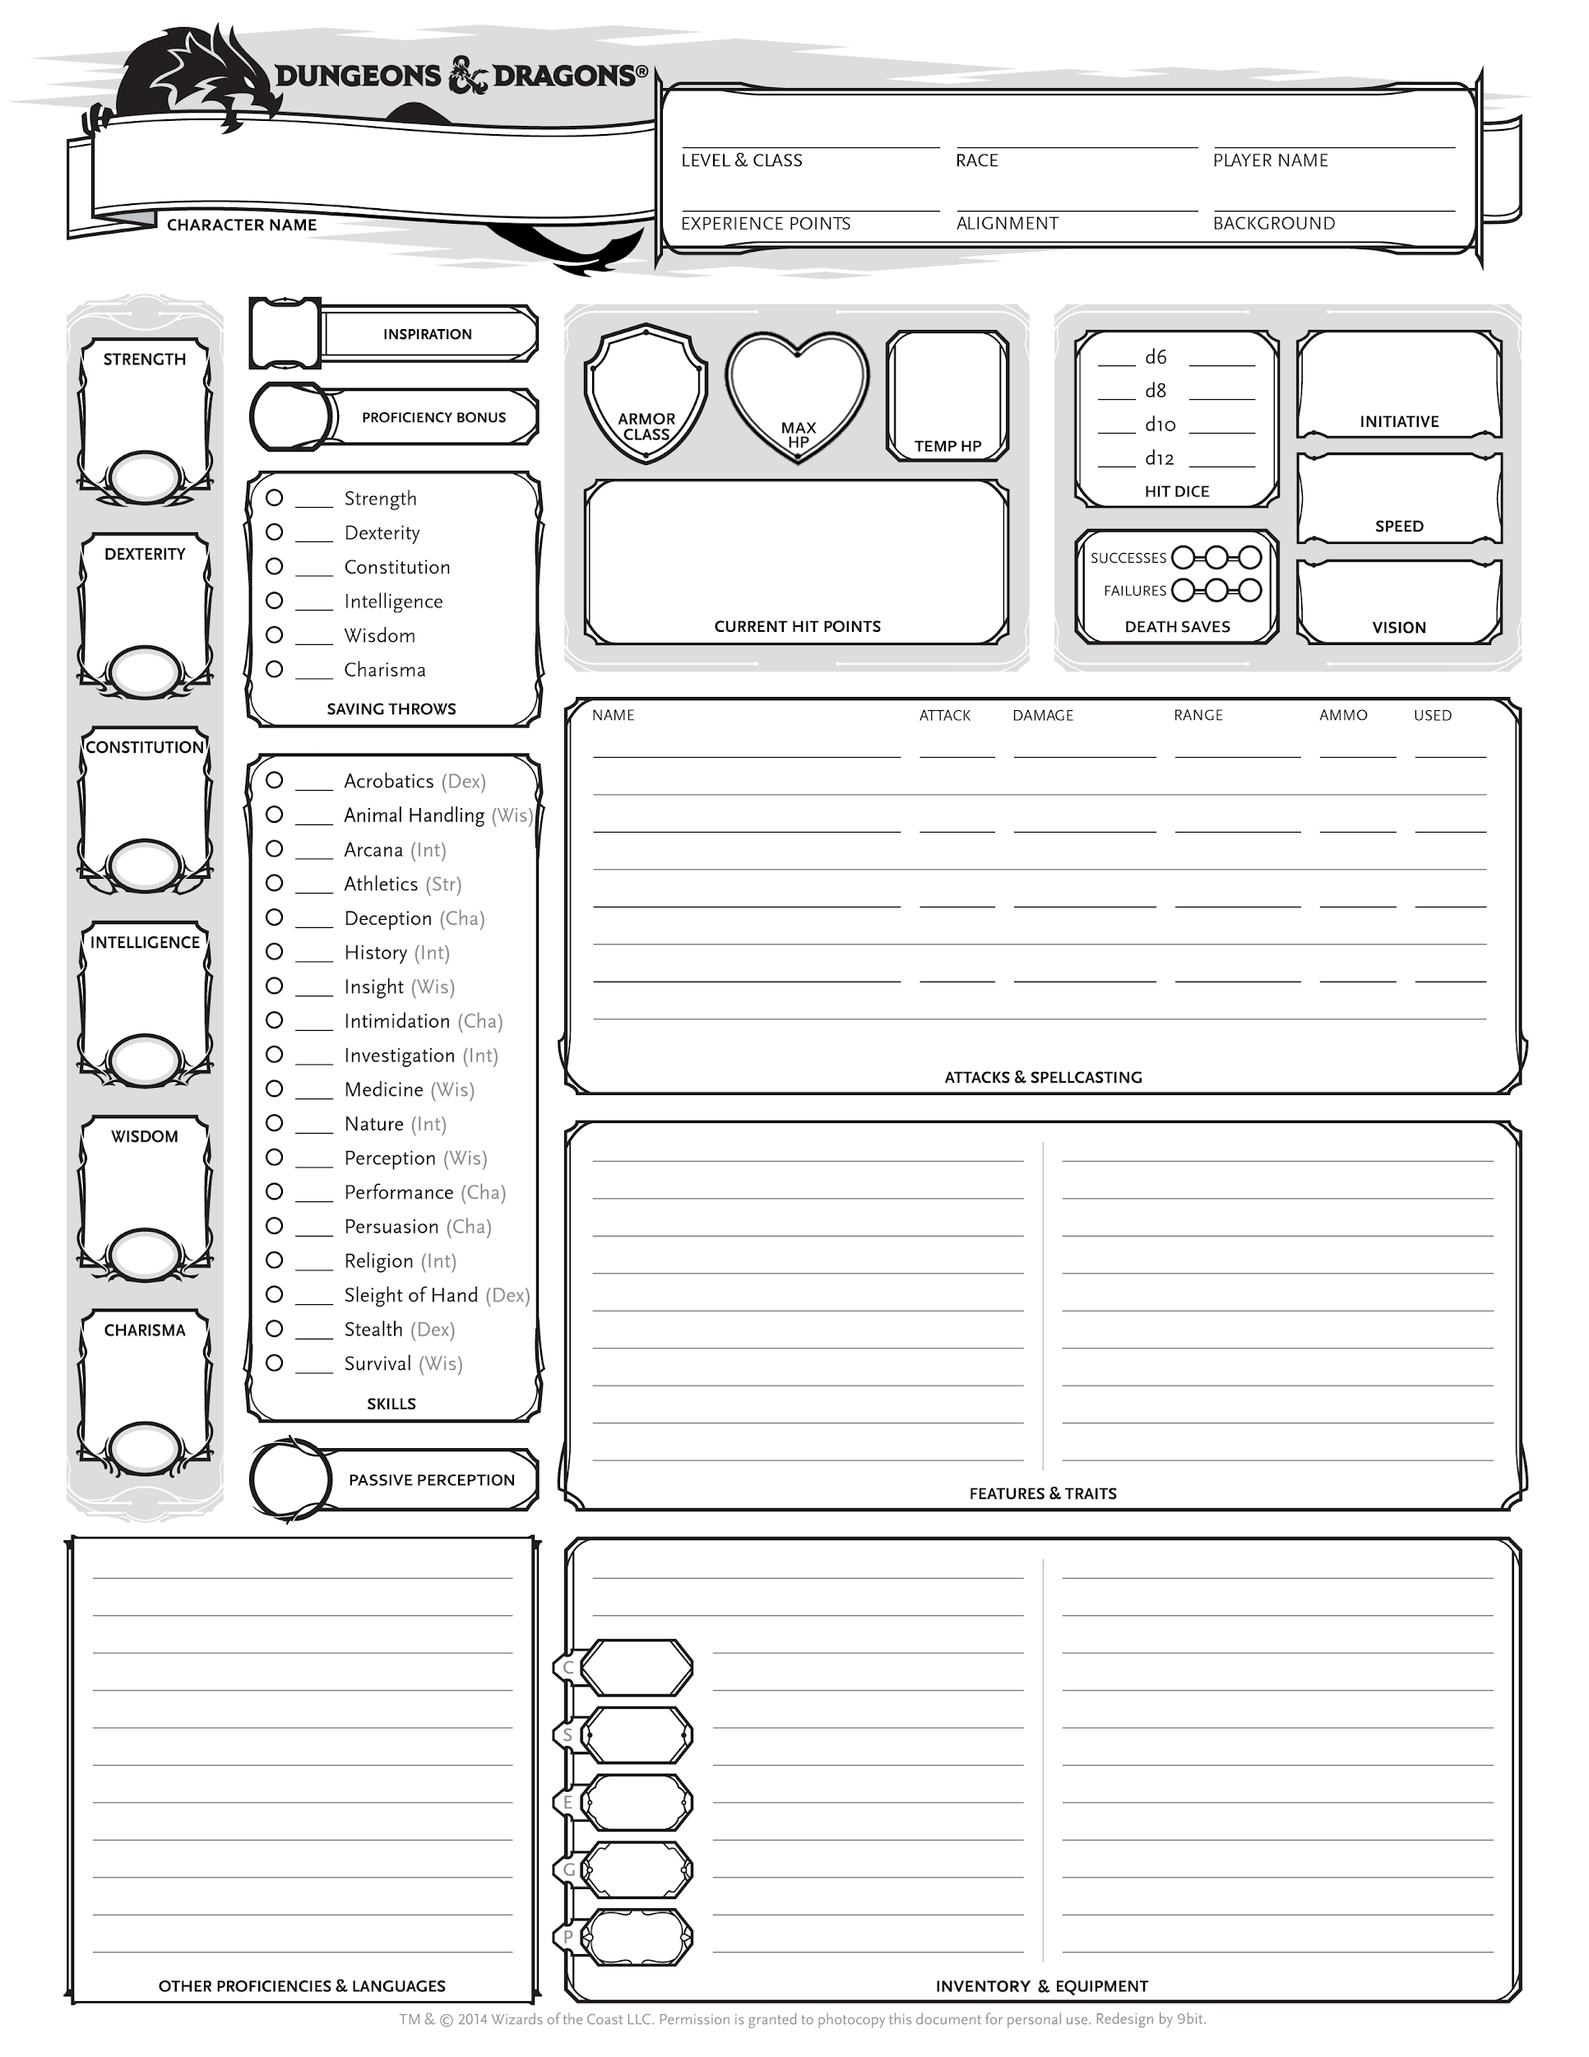
Character Sheets
Player character sheets saved on local machine
NPC and monster stats stored on database

Slide 6
DM’s Toolkit
Dice Roller
Button for each di, prints result to game log
Drag and Drop premade assets
NPCs with stats
Monsters with stats
Environment effects / objects
Turn order management

Slide 7
Connectivity
We will be implementing TCP Socket programming in Java using the java.net package of J2SE APIs.
Goal is to have a live updating screen across multiple devices, connected to the internet, and joined in the same session.

Slide 8
Other stuff - Spencer
Session code
Chat text box/Game Log
Map storage
2d array
Computer with java
Apache server
MySQL database

Slide 9
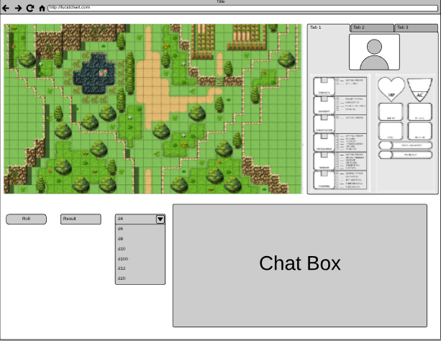
UI - Greg
Map
Character
Sheet
Dice Roller
Notes:
https://www.lucidchart.com/documents/view/0d09b72c-ce8c-43b3-86b5-cb0a29396702

Slide 10
Technical Definitions
DM - Dungeon Master; basically the person in charge of the game
NPC - Non-player Character
Character Sheet - File with all the necessary statistics for a character
TCP - transmission control protocol
Token - an icon to visually represent an object’s location within our software

